Slide 1

or Op Amps for short

Slide 2
Op Amps Applications
Audio amplifiers
  Speakers and microphone circuits in cell phones, computers, mpg players, boom boxes, etc.
Instrumentation amplifiers
  Biomedical systems including heart monitors and oxygen sensors.
Power amplifiers
Analog computers
  Combination of integrators, differentiators, summing amplifiers, and multipliers

Slide 3
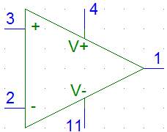
Terminals on an Op Amp
Positive power supply (Positive rail)
Non-inverting
Input terminal
Output terminal
Inverting input
terminal
Negative power supply
(Negative rail)

Slide 4
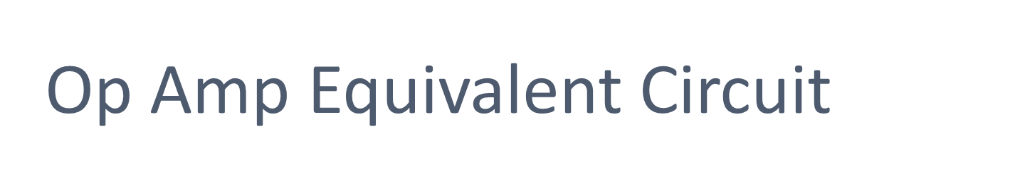
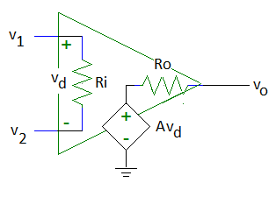
v_{d} = v₂ – v₁
A is the open-loop voltage gain
v₂
v₁
Voltage controlled voltage source

Slide 5
Typical Op Amp Parameters
Parameter | Variable | Typical Ranges | Ideal Values
Open-Loop Voltage Gain | A | 10⁵ to 10⁸ | ∞
Input Resistance | Ri | 10⁵ to 10¹³ Ω | ∞ Ω
Output Resistance | Ro | 10 to 100 Ω | 0 Ω
Supply Voltage | Vcc/V⁺ -Vcc/V⁻ | 5 to 30 V -30V to 0V | N/A N/A

Slide 6
How to Find These Values
Component Datasheets
  Many manufacturers have made these freely available on the internet
    Example: LM 324 Operational Amplifier

Slide 7
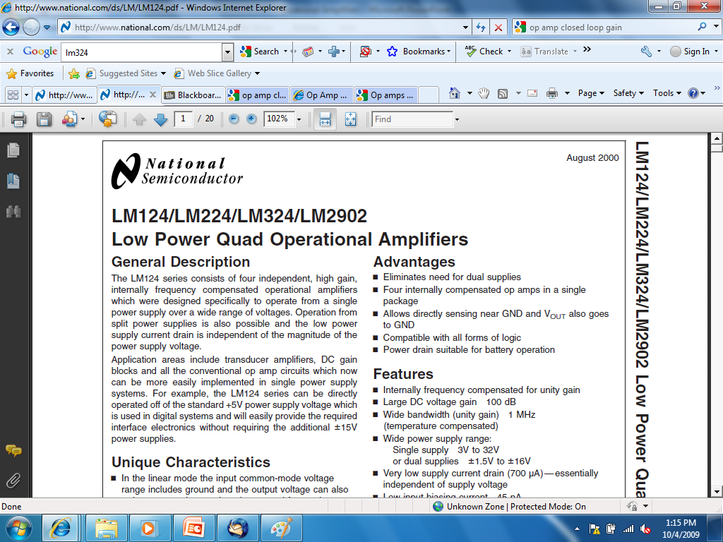

Slide 8
dB
Decibels
Since P = V²/R
  10 log (P/P_{ref}) or 20 log (V/V_{ref})
In this case:
20 log (V_{o}/V_{in}) = 20 log (A) = 100
A = 10⁵ = 100,000

Slide 9
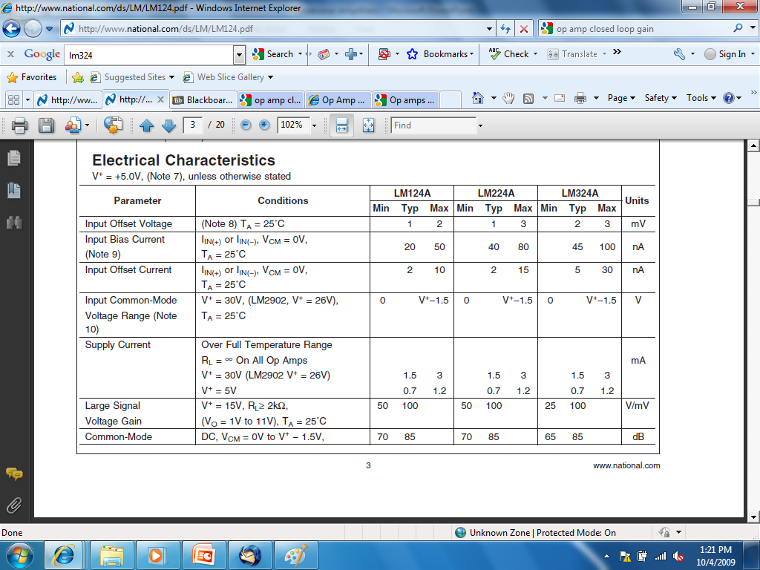

Slide 10
Large Signal Voltage Gain = A
Typical
  A = 100 V/mV = 100V/0.001V = 100,000
Minimum
  A = 25 V/mV = 25 V/0.001V = 25,000

Slide 11
Operational Amplifiers (Op Amps)
Ideal Op Amp
Non-inverting Amplifier
Unity-Gain Buffer
Inverting Amplifier
Differential Amplifier
Current-to-Voltage Converter
Non-ideal Op Amp

Slide 12
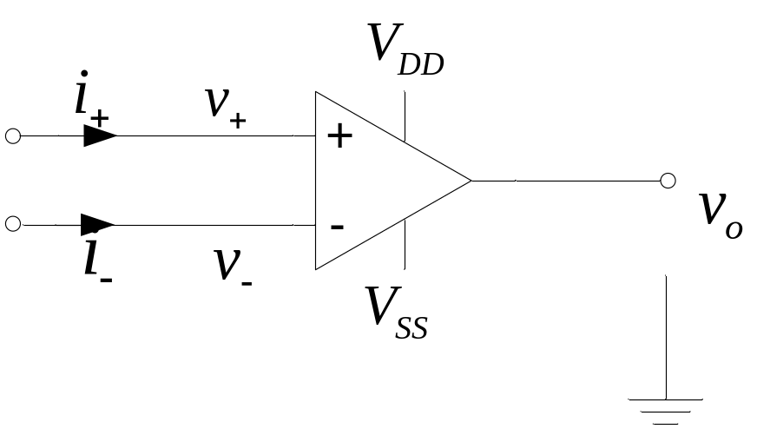
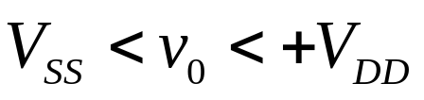
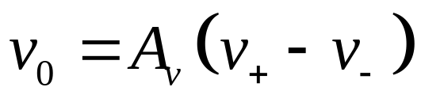
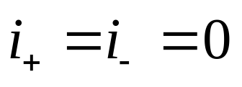
Ideal Op Amp
1)
The open-loop gain, A_{v}, is very large, approaching infinity.
2)
The current into the inputs are zero.

Slide 13

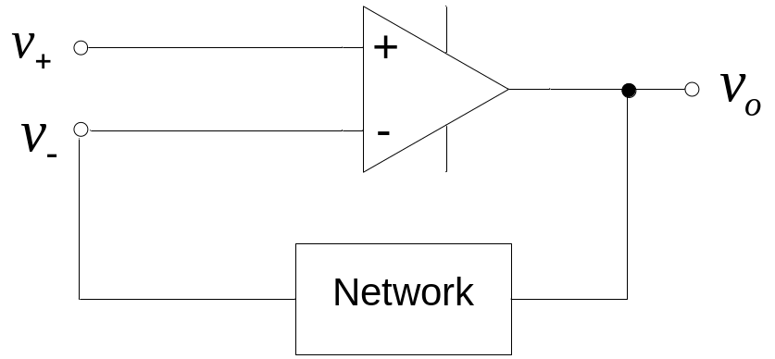
Golden Rules of Op Amps:
The output attempts to do whatever is necessary to make the voltage difference between the inputs zero.
The inputs draw no current.

Slide 14
Operational Amplifiers (Op Amps)
Ideal Op Amp
Non-inverting Amplifier
Unity-Gain Buffer
Inverting Amplifier
Differential Amplifier
Current-to-Voltage Converter
Non-ideal Op Amp

Slide 15
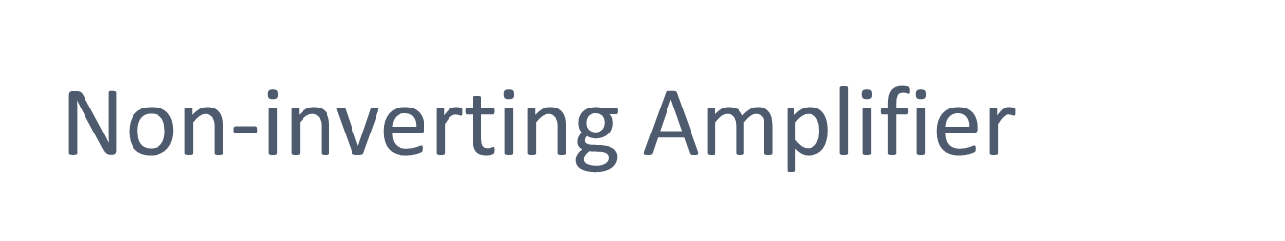
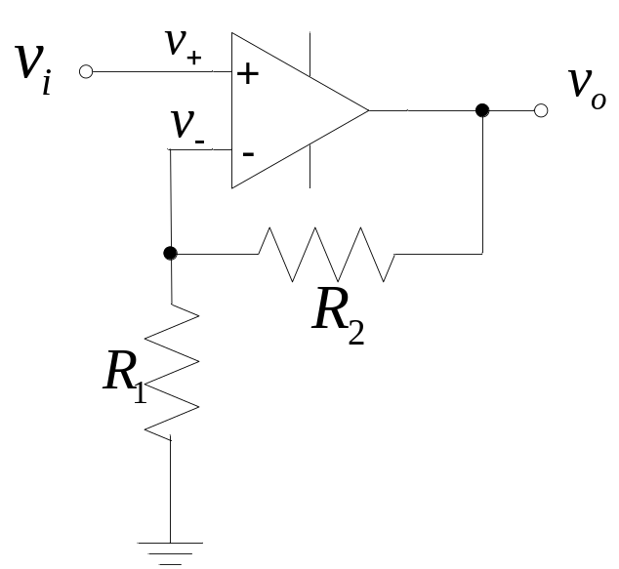
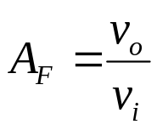
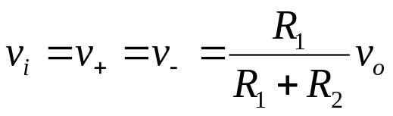
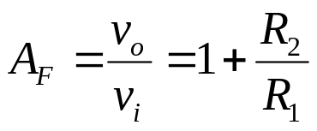
Closed-loop voltage gain

Slide 16
Operational Amplifiers (Op Amps)
Ideal Op Amp
Non-inverting Amplifier
Unity-Gain Buffer
Inverting Amplifier
Differential Amplifier
Current-to-Voltage Converter
Non-ideal Op Amp

Slide 17

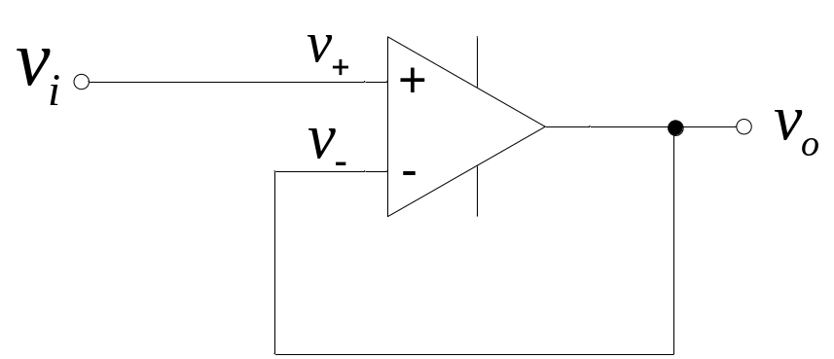

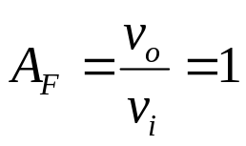
Closed-loop voltage gain
Used as a "line driver" that transforms a high input impedance (resistance) to a low output impedance. Can provide substantial current gain.

Slide 18
Operational Amplifiers (Op Amps)
Ideal Op Amp
Non-inverting Amplifier
Unity-Gain Buffer
Inverting Amplifier
Differential Amplifier
Current-to-Voltage Converter
Non-ideal Op Amp

Slide 19

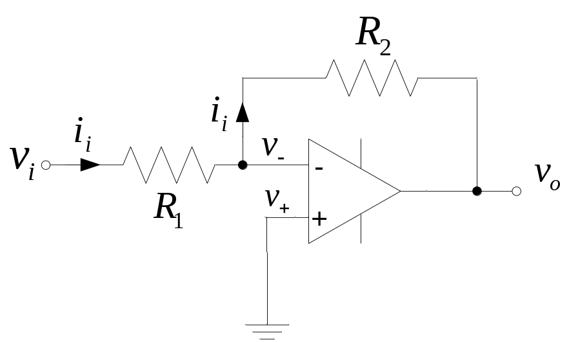

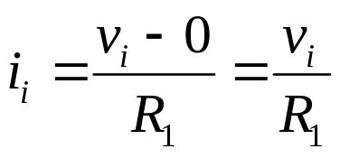
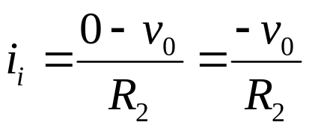
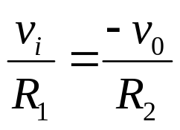
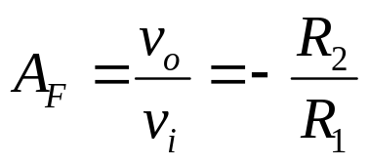
Current into op amp is zero

Slide 20
Operational Amplifiers (Op Amps)
Ideal Op Amp
Non-inverting Amplifier
Unity-Gain Buffer
Inverting Amplifier
Differential Amplifier
Current-to-Voltage Converter
Non-ideal Op Amp

Slide 21

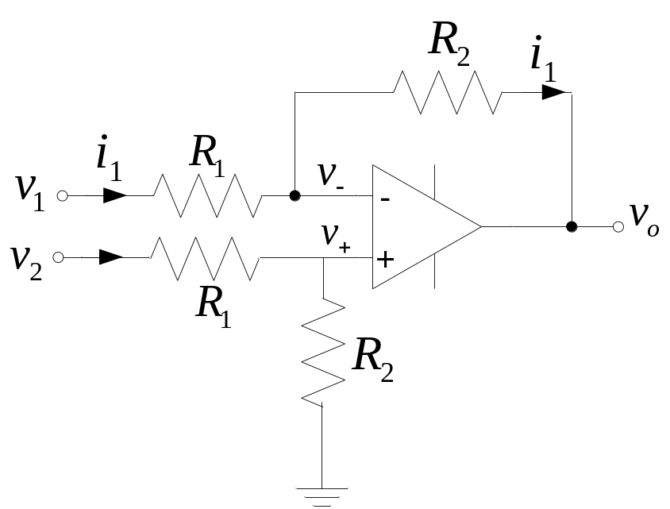

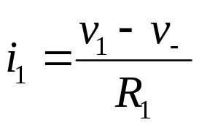
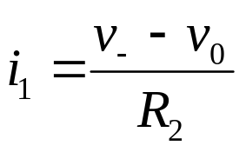
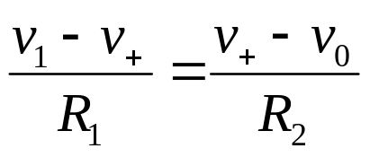
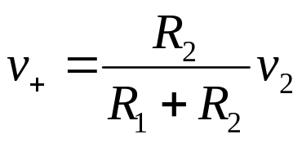
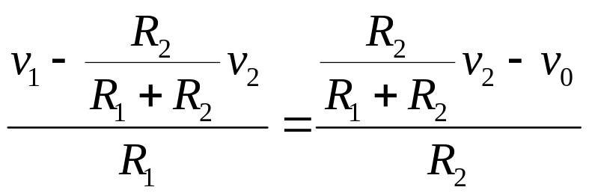
Current into op amp is zero

Slide 22
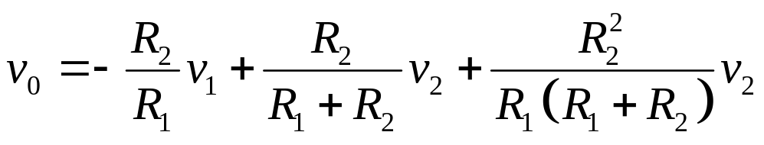
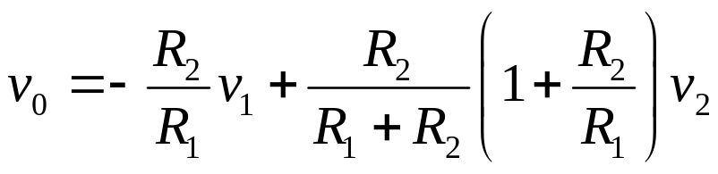
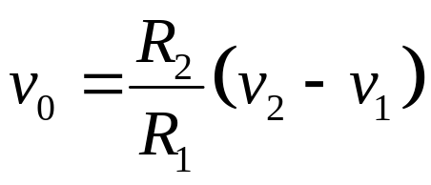

Slide 23
INVERTING SUMMING AMPLIFIER
R₁
R_{F}
v₁
R₂
v₂
-
R₃
v_{o}
0 V
v₃
+

Slide 24
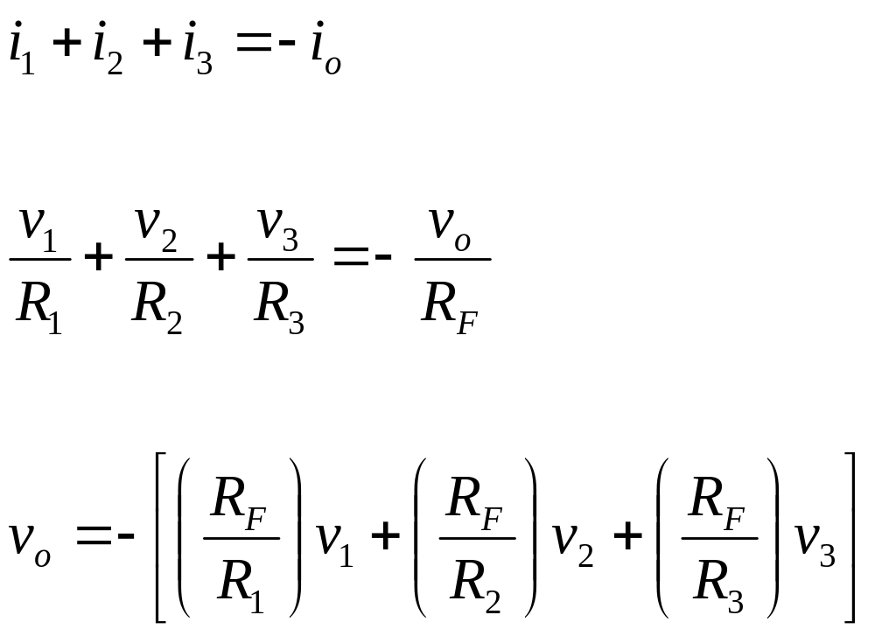
GAIN CALCULATIONS

Slide 25

R₃
v₃
R₂
v₂
R₁
v₁
+
v_{O}
-
R_{F}
R_{A}

Slide 26

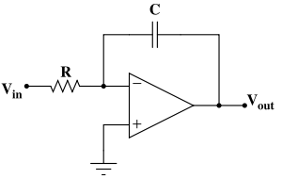


Slide 27

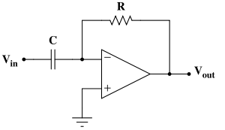

(where V_{in} and V_{out} are functions of time)

Slide 28

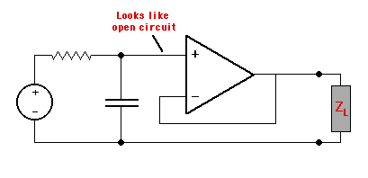
Decouple the low-pass RC filter from the load.
Uses: Simple audio. Remove frequencies over 20kHz (audible)

Slide 29
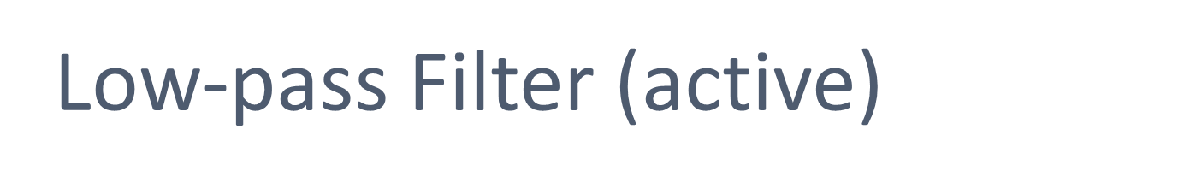
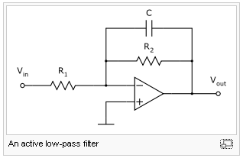
Cutoff frequency
This works because the capacitor needs time to charge.

